Slide 1
Admin Panel

Slide 2
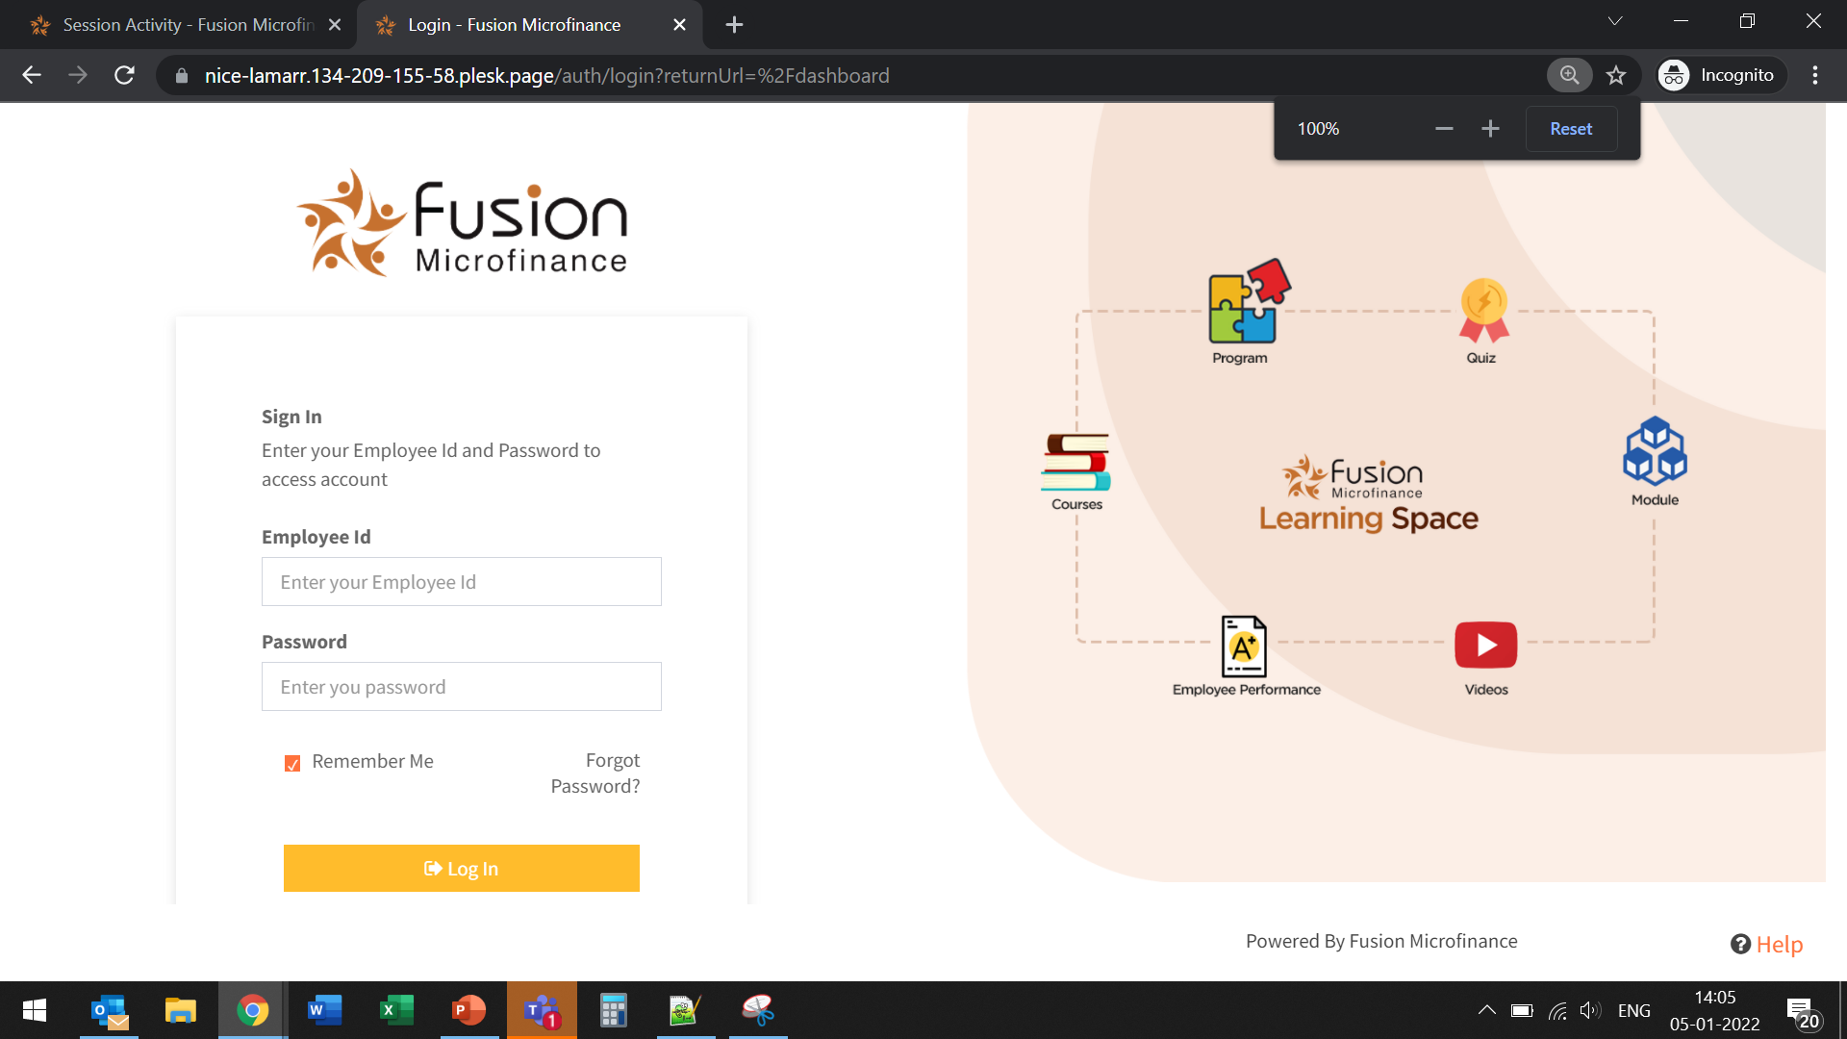
Please remove this statement.
UI/UX Issue at 100% zoom.

Slide 3
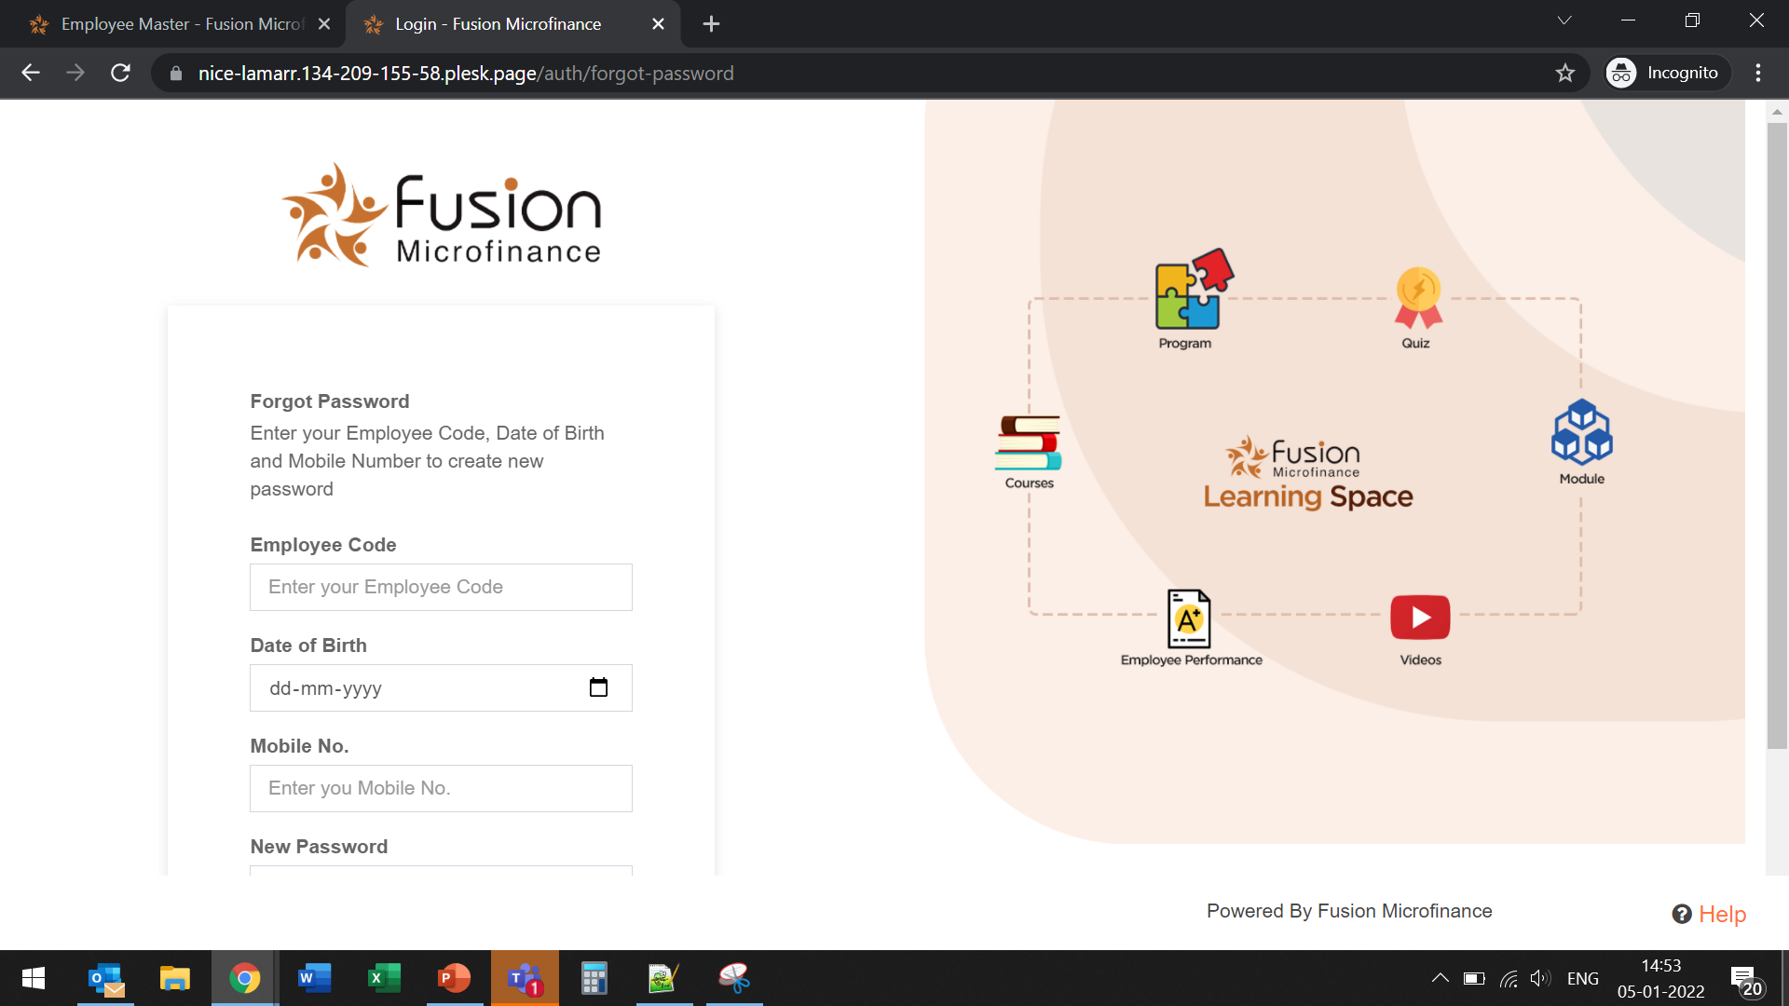
Please remove this statement.
UI/UX Issue at 100% zoom.
Also, no option available to go back to login page.

Slide 4
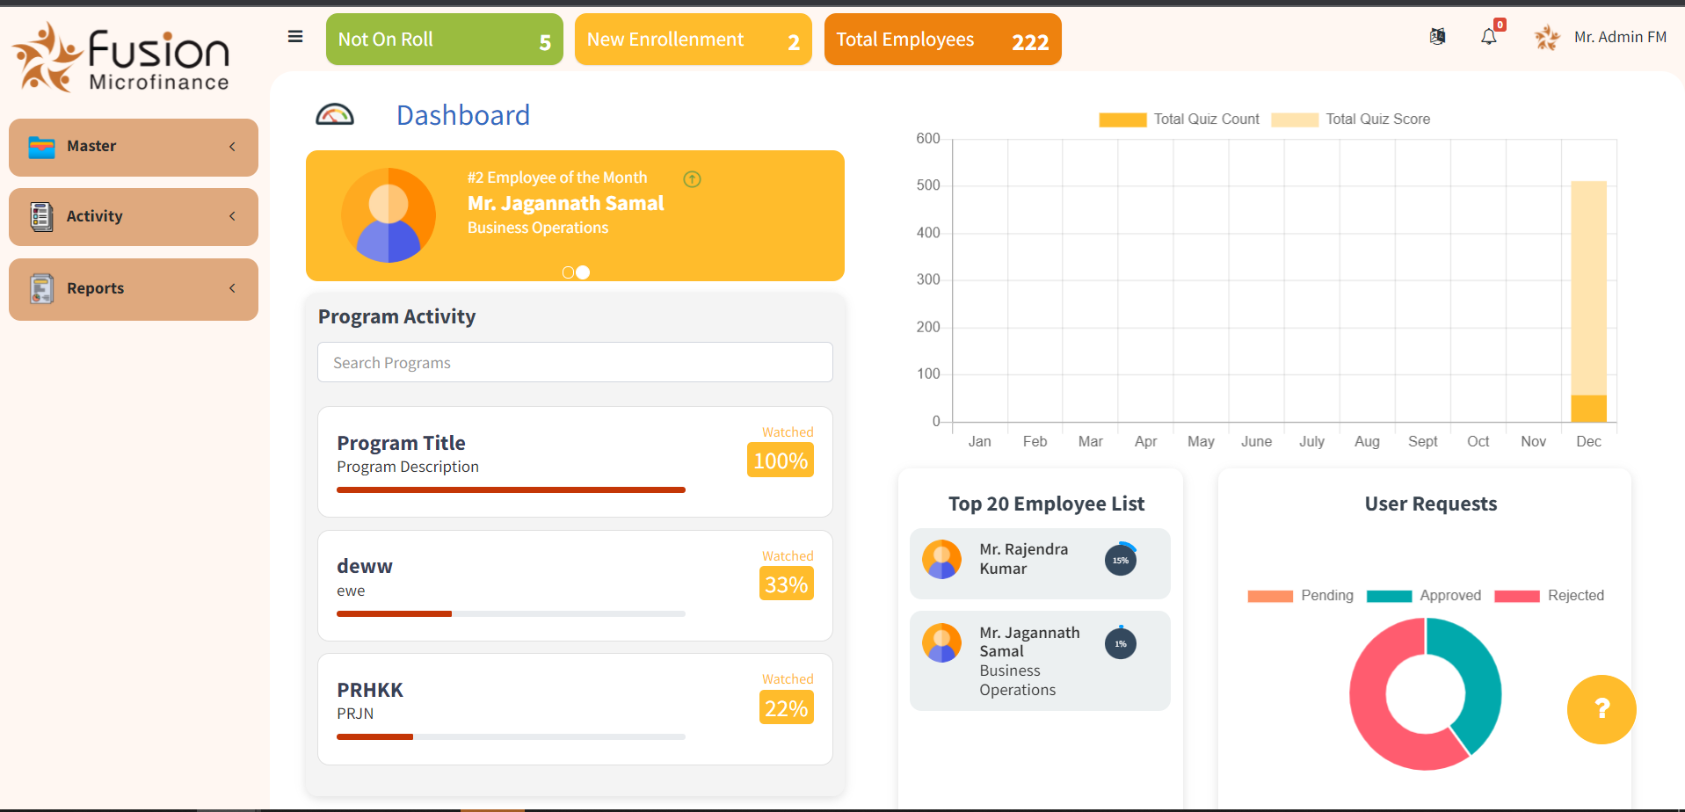
Notify option is missing.
Paging (Auto Slider) should be there.
Paging (Auto Slider) should be there.

Slide 5
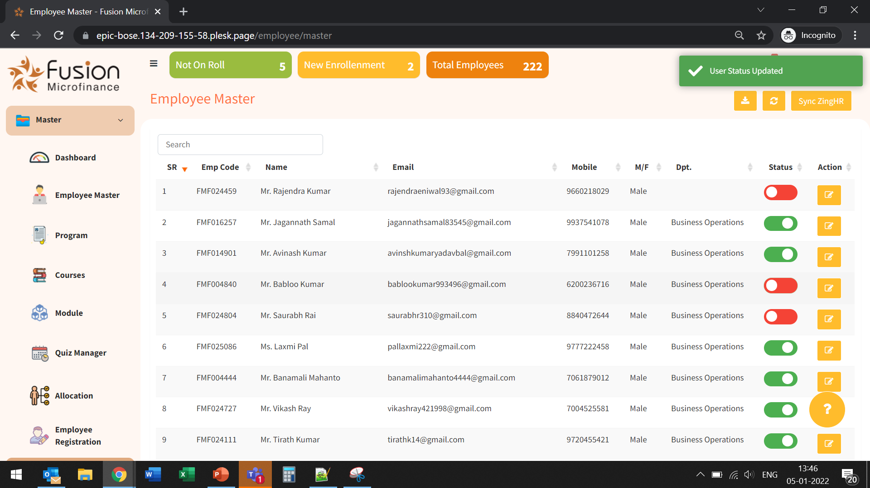
Done
Status shade is not consistent throughout. Its still showing green irrespective of any status.

Slide 6
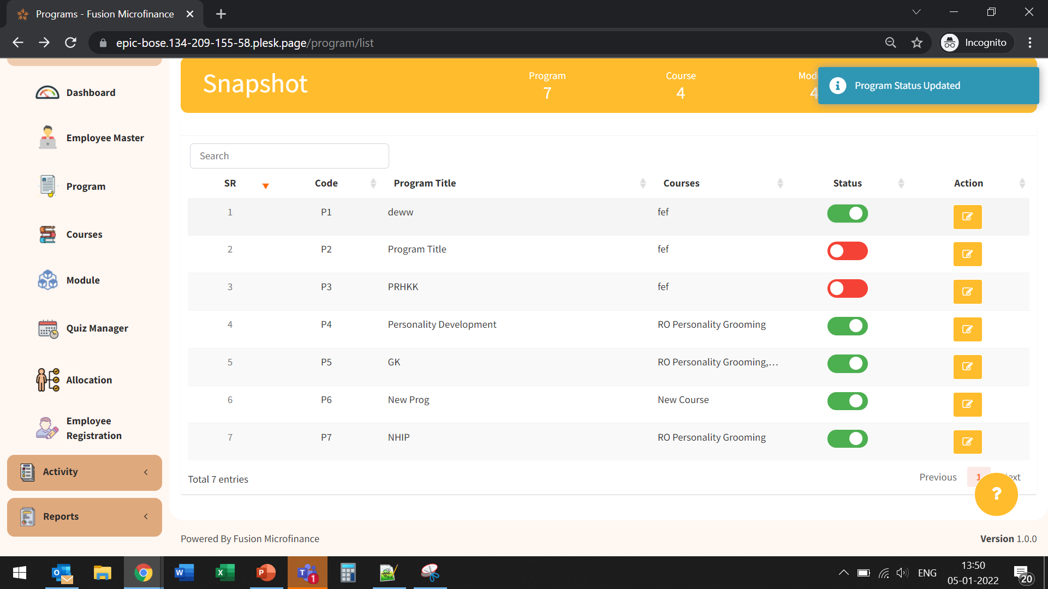
Done
Status shade is not consistent throughout. Its still showing green irrespective of any status.
Status shade is not consistent throughout. Its still showing green irrespective of any status.

Slide 7
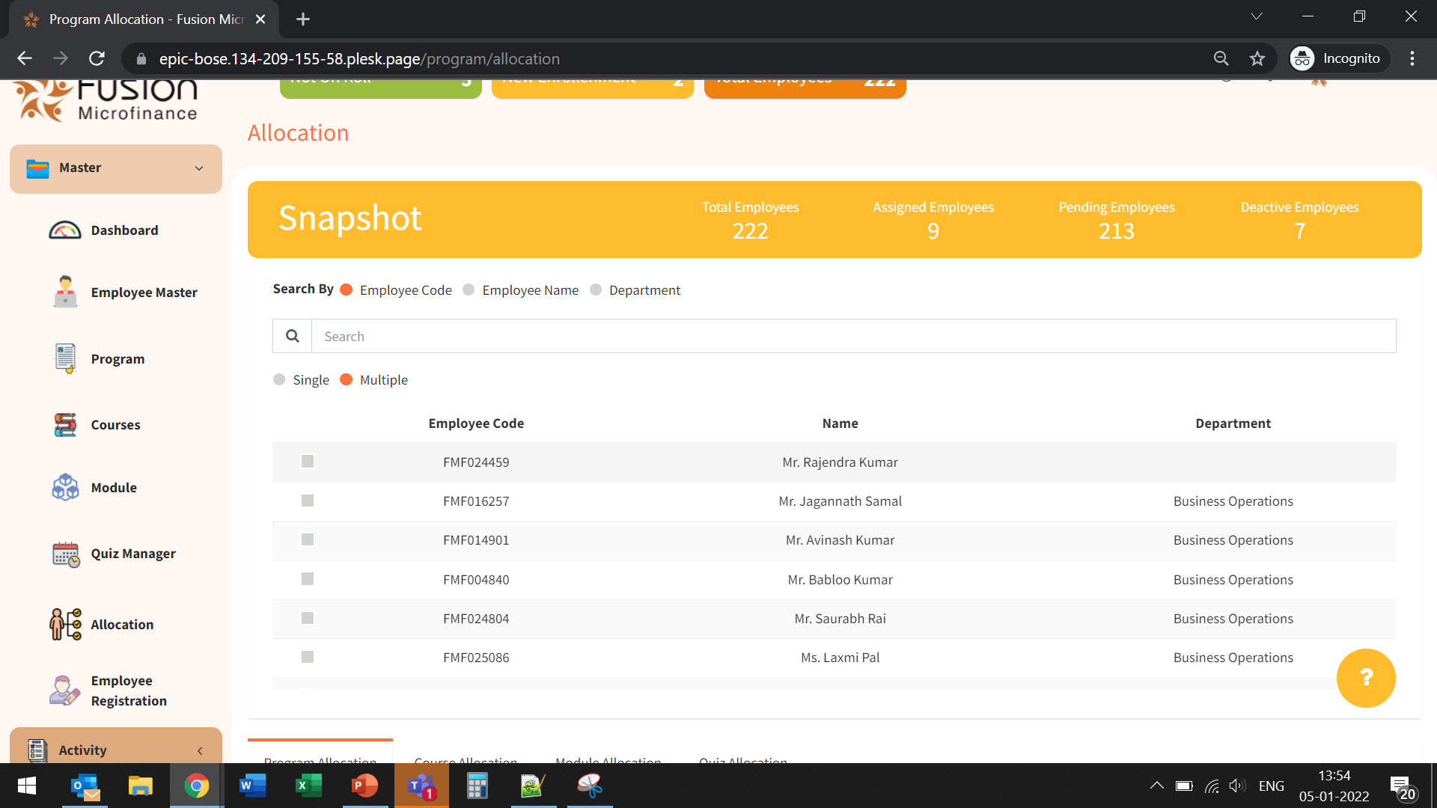
Select All (Checkbox) should be provided.
Paging should be provided throughout these kind of interfaces.

Slide 8
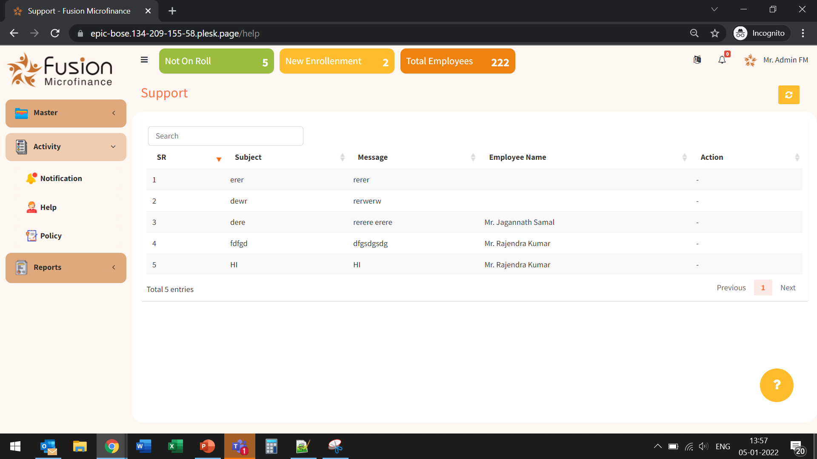
Done
No action option is available.

Slide 9
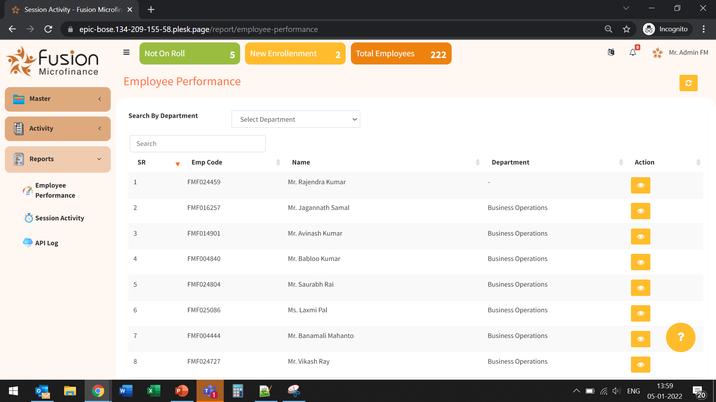
No option/report available to see joint performance of any department.

Slide 10
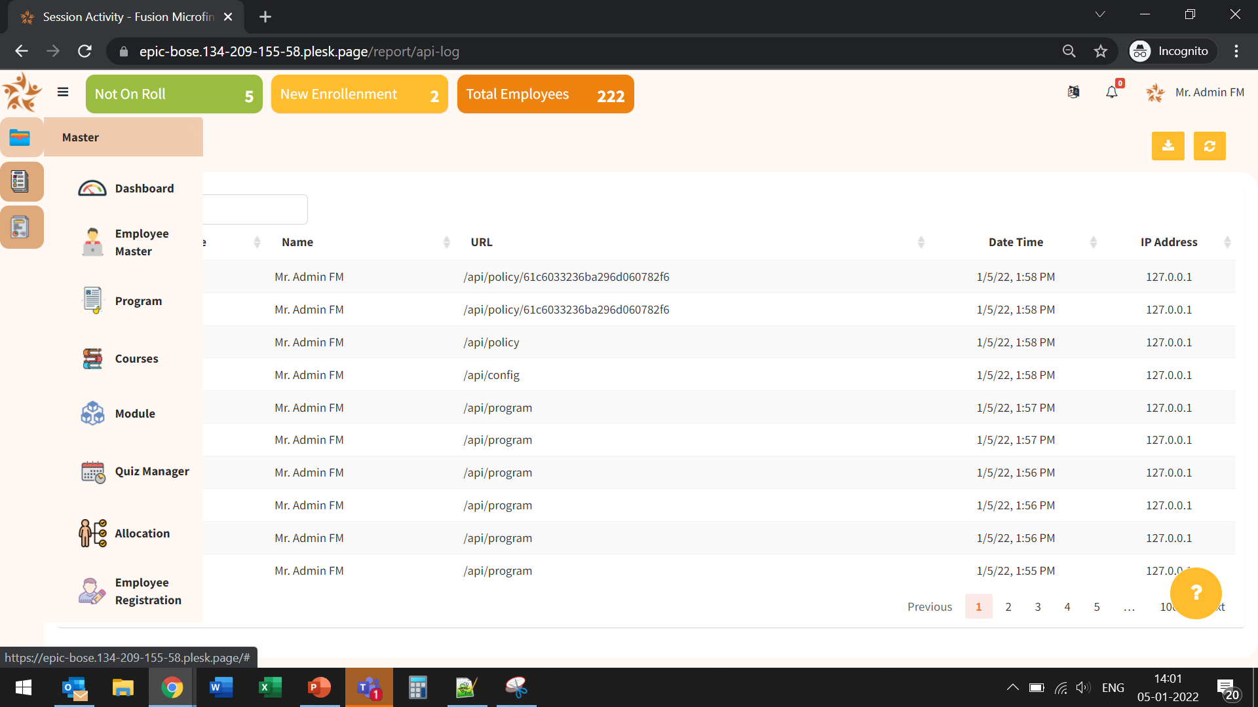
Done
Corners should be rounded.

Slide 11
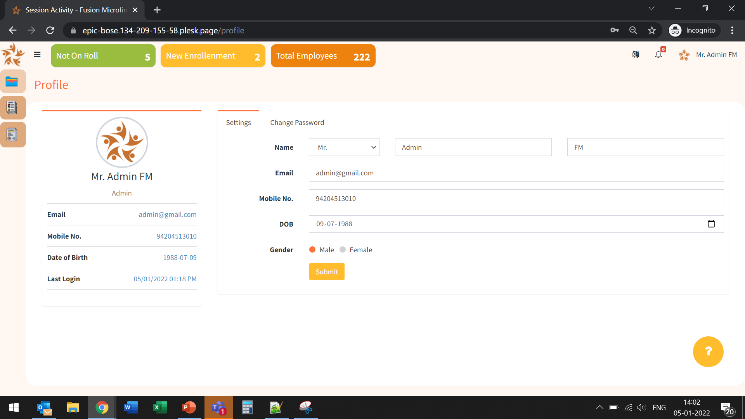
Done
DIV area should be consistent.

Slide 12
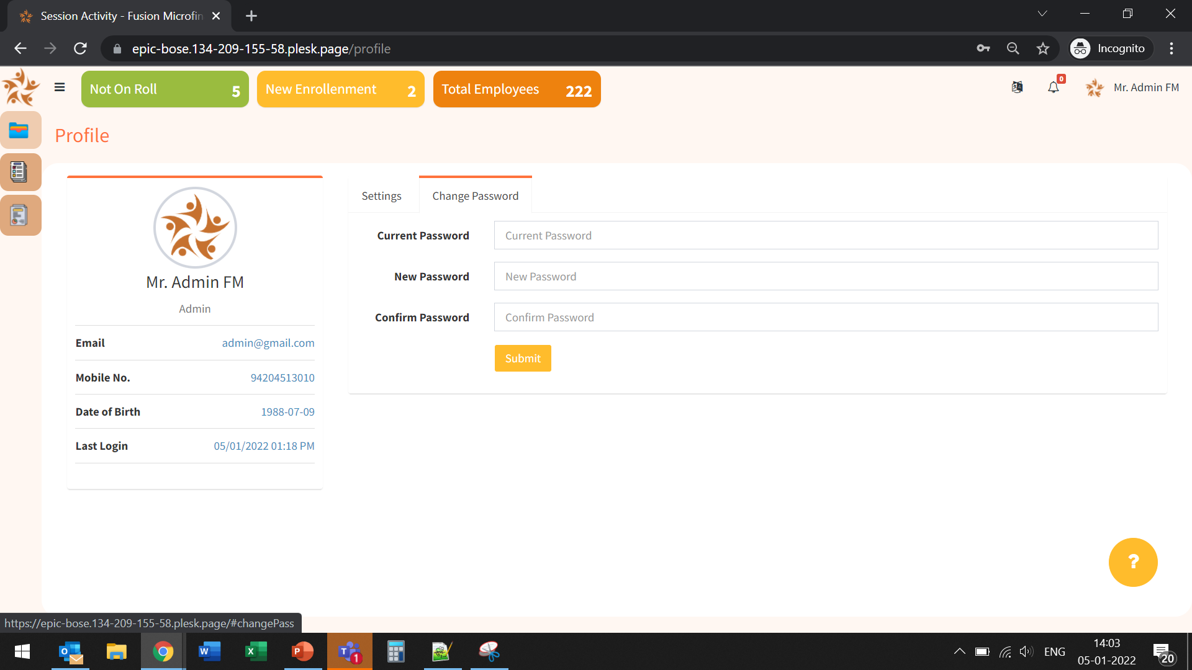
Done
DIV area should be consistent.

Slide 13
Employee Panel

Slide 14
Please remove this statement.
UI/UX Issue at 100% zoom.
Also, no option available for Mobile Number Change as designed in UI/UX.

Slide 15
Please remove this statement.
UI/UX Issue at 100% zoom.
Also, no option available to go back to login page.

Slide 16
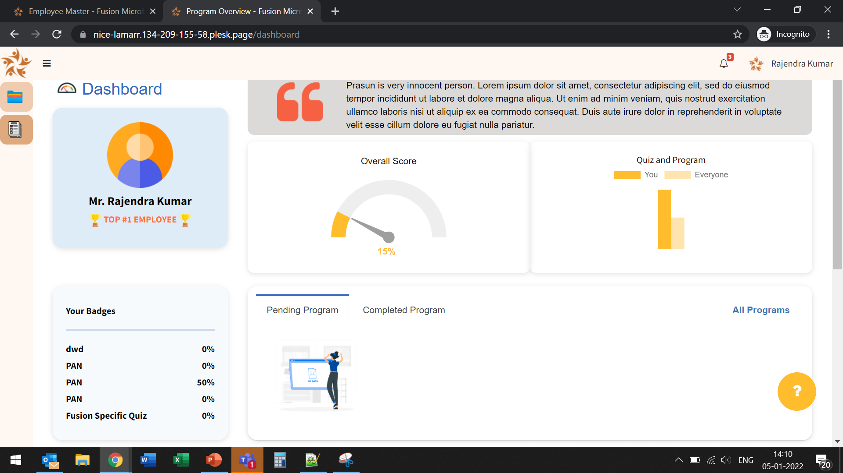
Done
Program assigned is not showing in Pending section.

Slide 17
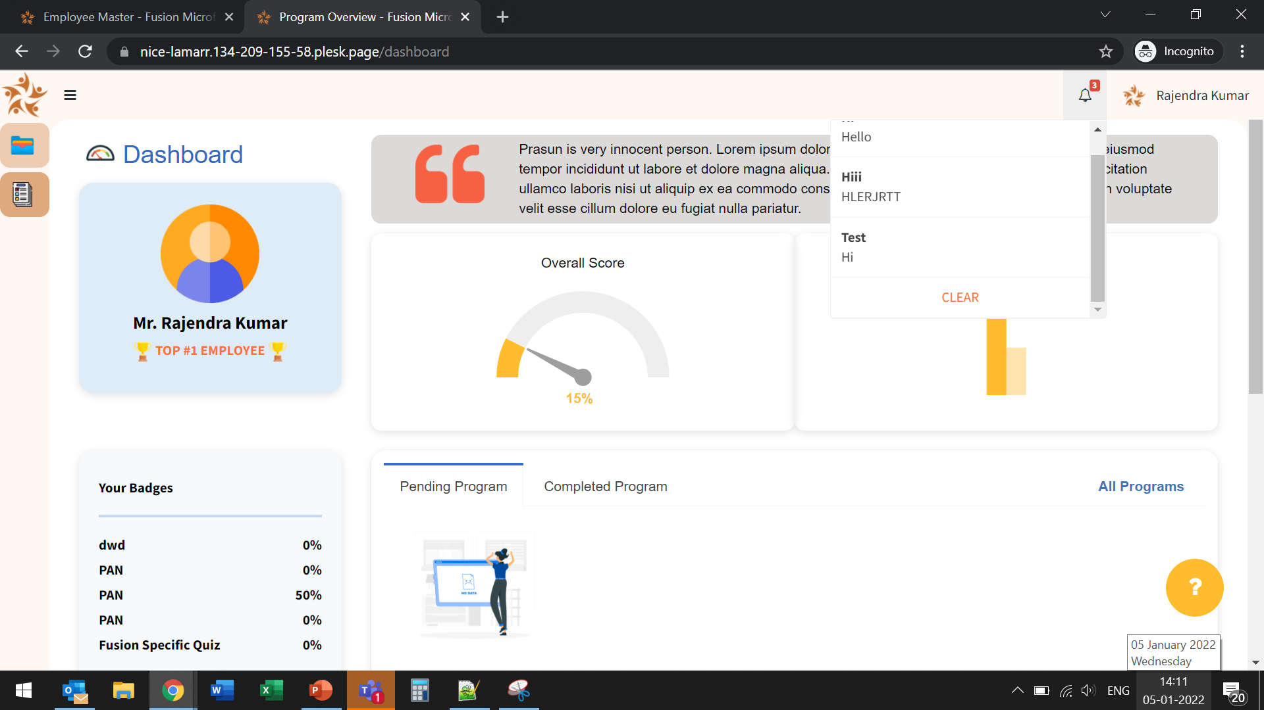
Done
Notification is getting displayed but cannot see thumbnail.

Slide 18
Done
DIV area should be consistent.

Slide 19
Done
DIV area should be consistent.

Slide 20
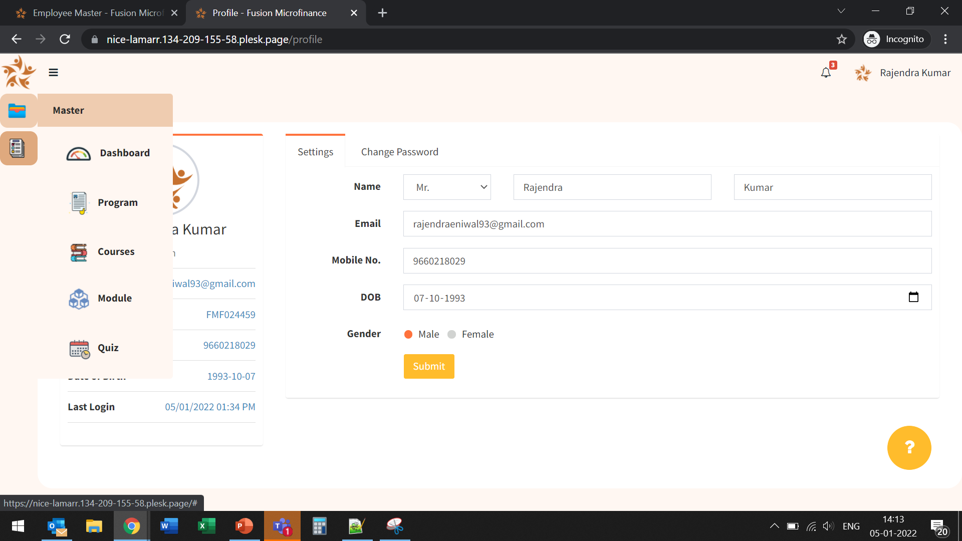
Done
Corners should be rounded.

Slide 21
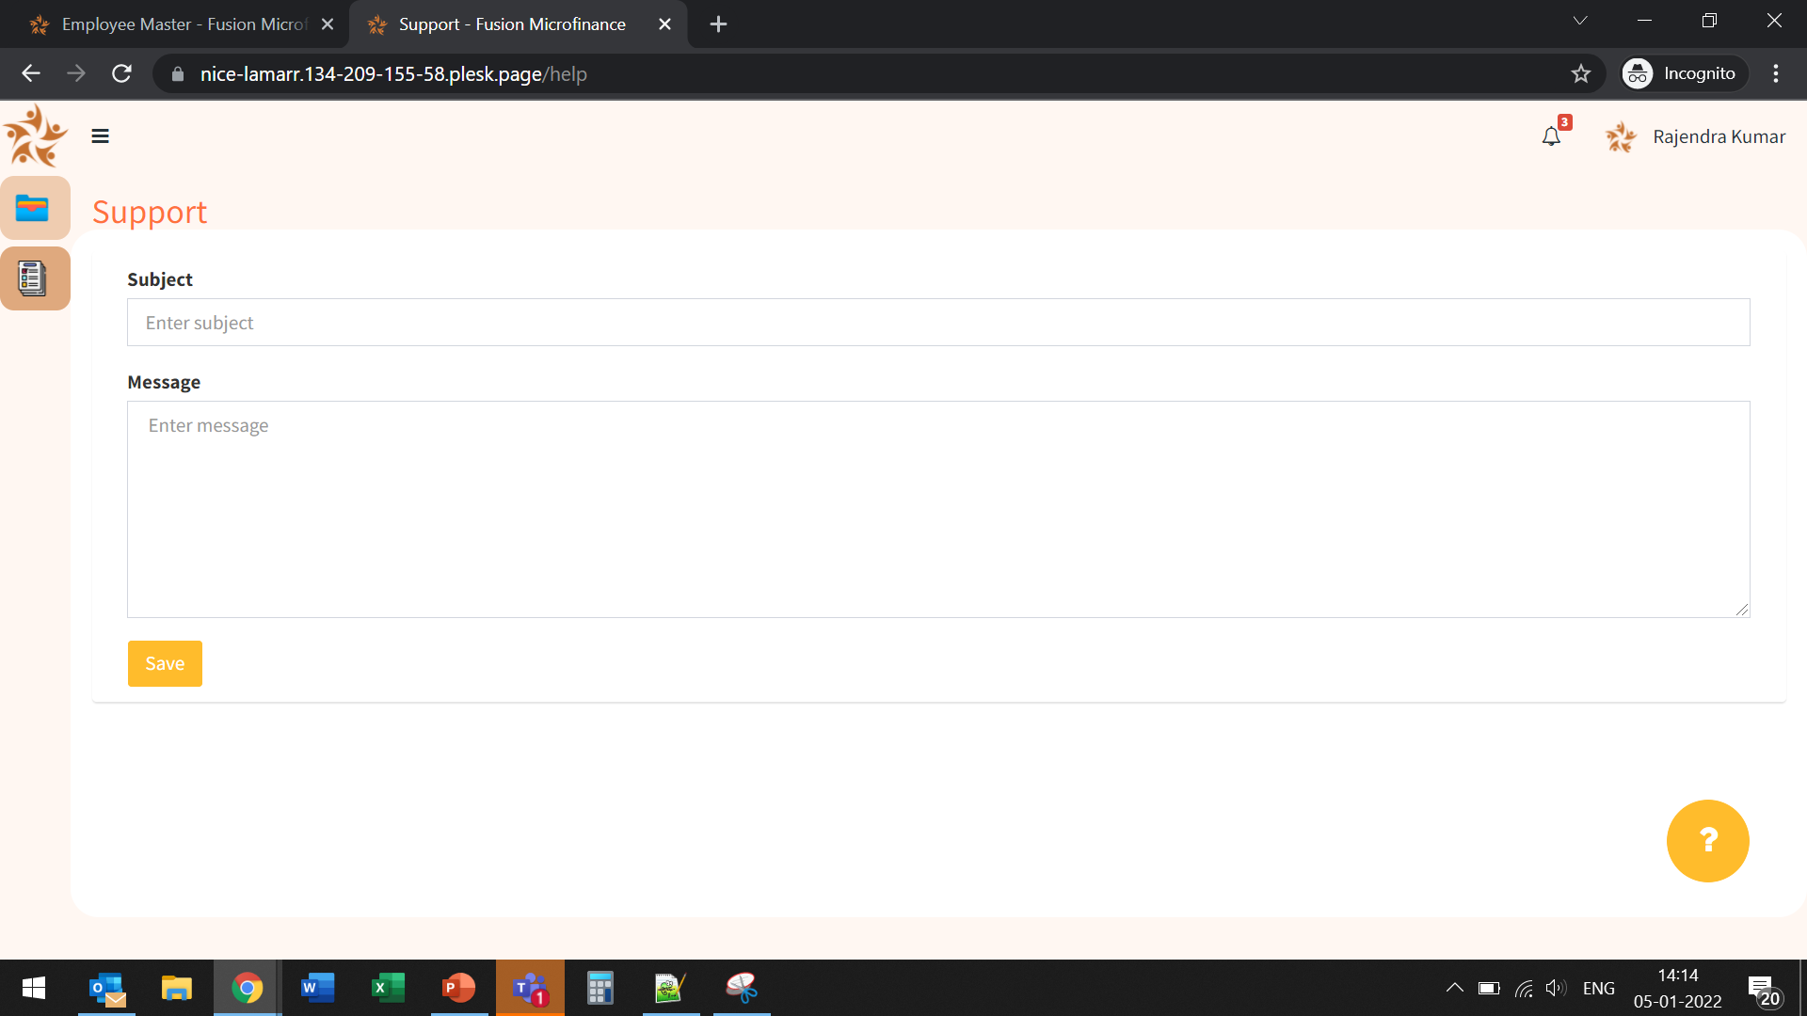
Done
No option is there to upload anything. DOC/PDF/Image.

Slide 22
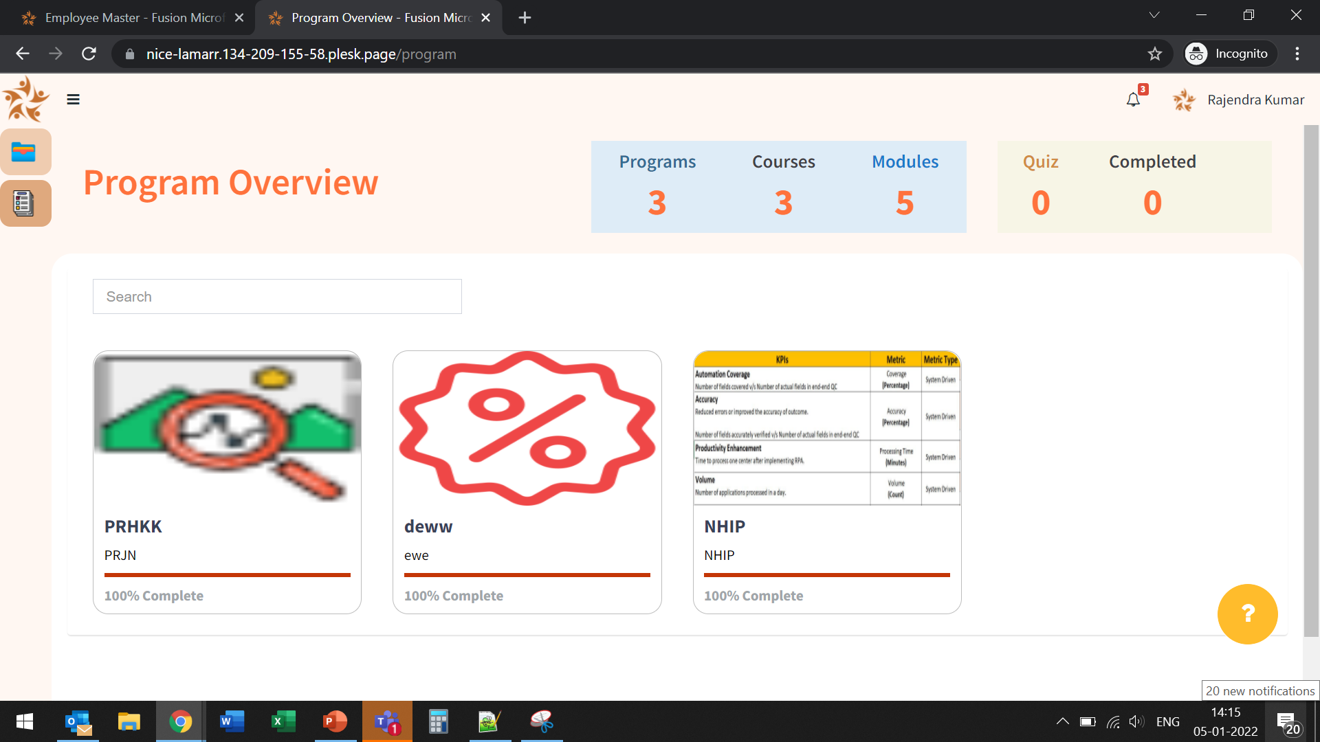
Quiz and Completed is not incrementing the value.

Slide 23
Done
This program is not attended yet. Still, showing 100%.

Slide 24
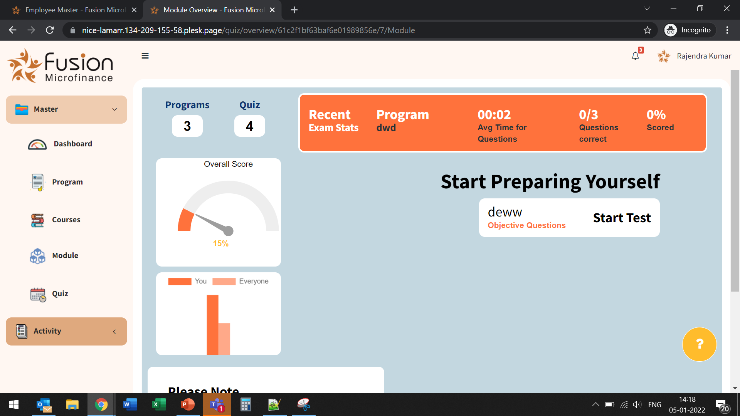
It should be Quiz.
Done
UI/UX Issue
It should be Start Quiz. Also, it should be highlighted like a button.

Slide 25
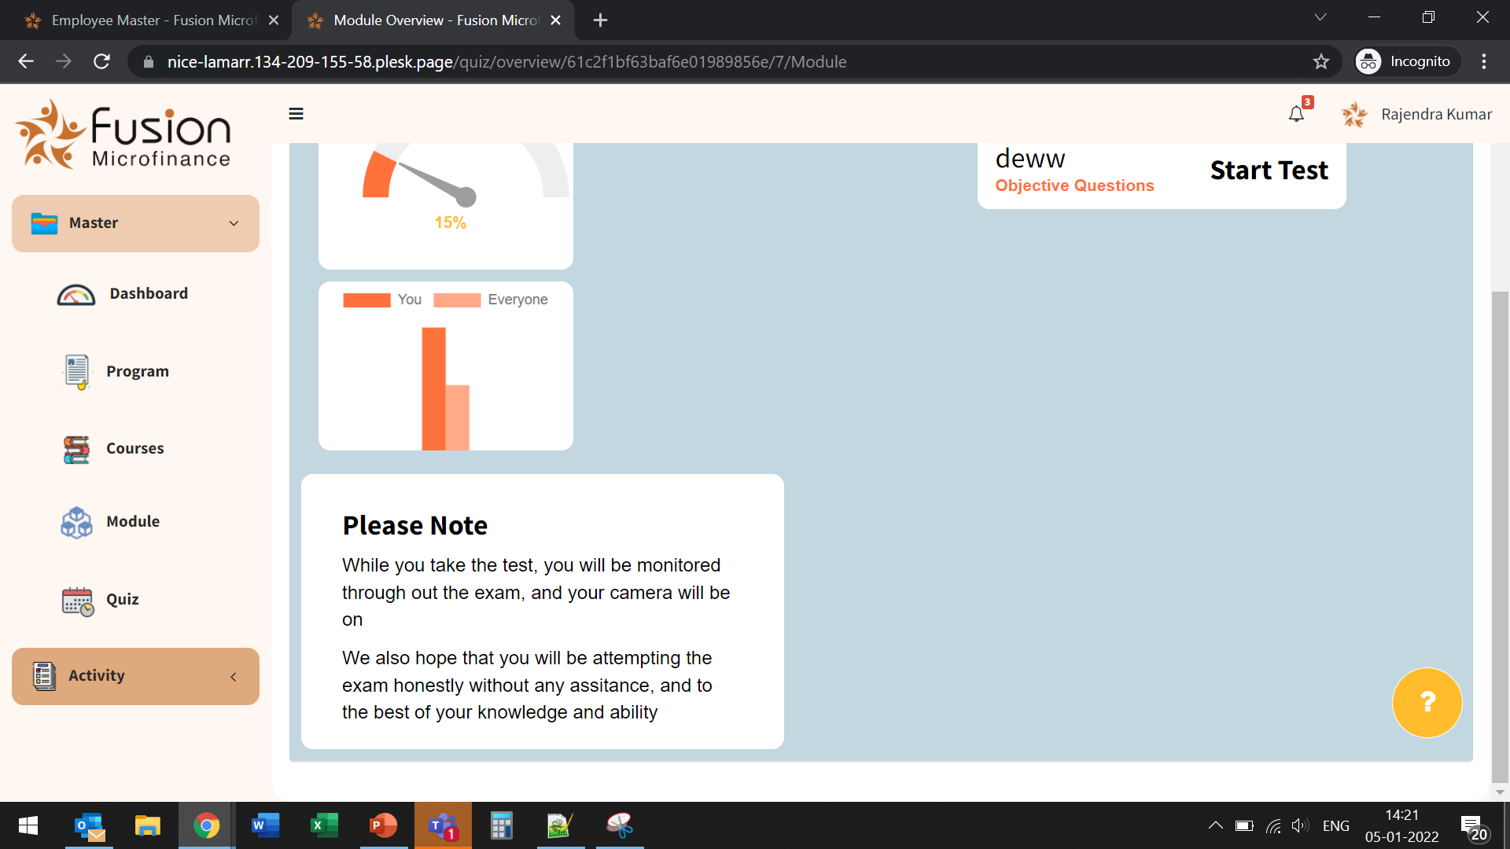
Done
Please remove this.

Slide 26
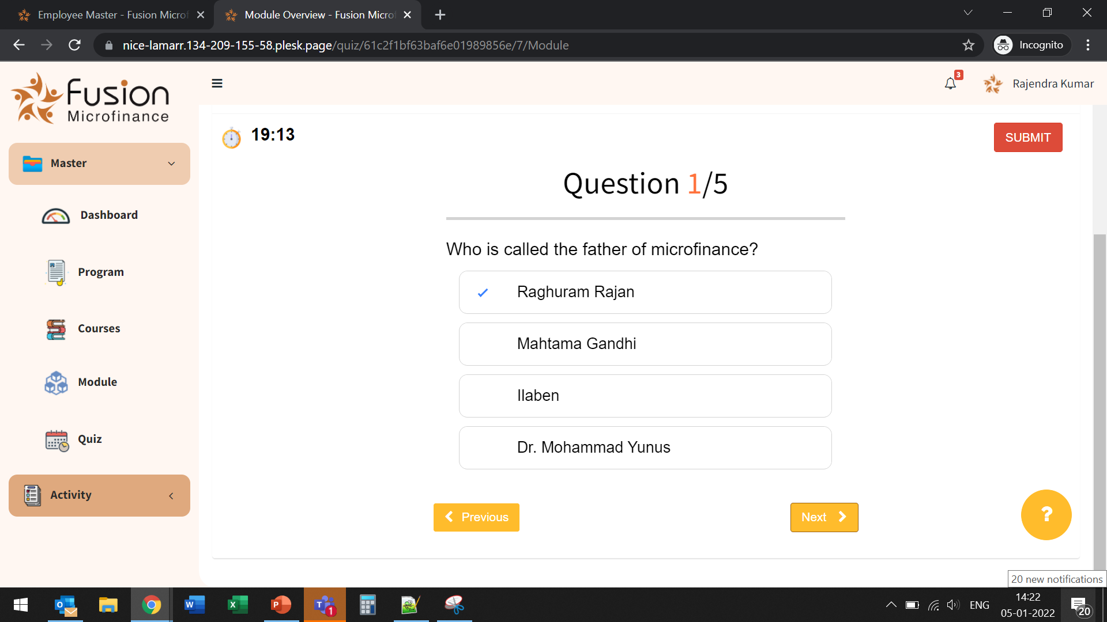
Done
Questions are not moving.

Slide 27
